Slide 1
UNSUPERVISED LEARNING

Slide 2
Unsupervised learning is a type of machine learning where the algorithm is trained on a dataset without any explicit supervision or labeled data.
The main difference between supervised and unsupervised learning is that in supervised learning, the algorithm is trained on labeled data, where each data point is associated with a specific output or target value.
In unsupervised learning, the algorithm is trained on unlabeled data, and the goal is to find hidden patterns or relationships in the data.
Unsupervised learning algorithms can be used for a variety of tasks, such as clustering, dimensionality reduction, and anomaly detection.

Slide 3
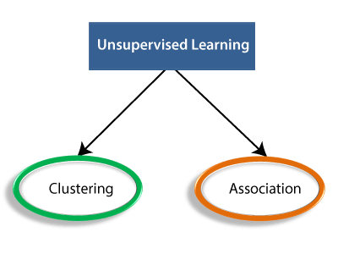

Slide 4
Clustering:
The main objective of clustering is to identify patterns and structures in the data that are not easily identifiable by human intuition.
In clustering, the algorithm tries to identify groups of data points that are similar to each other based on their features or characteristics.
Types: 1. K-means 2.hierarchial clustering 3.DSBSCAN

Slide 5
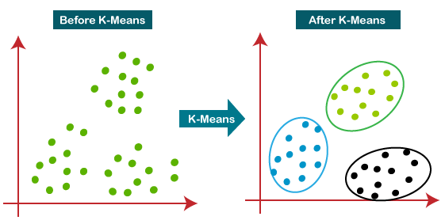
1.K means:
K-means is a popular clustering algorithm in machine learning that is used to group similar data points together into k number of clusters.
The k-means algorithm starts by randomly selecting k centroids from the data points.
Then, each data point is assigned to the nearest centroid based on the Euclidean distance between the data point and the centroid.
After all the data points have been assigned to a centroid, the algorithm recalculates the centroid by taking the mean of all the data points in that cluster.
This process is repeated until the centroids no longer change, or a maximum number of iterations is reached.

Slide 6
Algorithm for k means:
1. Choose the number of clusters k and randomly select k data points from the dataset as the initial centroids.
2. while (not converged):
for each data point:
calculate the distance to each centroid #a centroid is the arithmetic mean of all the points in a cluster.
assign the data point to the nearest centroid
for each centroid:
calculate the mean of all the data points assigned to it
update the centroid to the mean
if (the centroids do not change):
converged = True
3. return the final clusters and their respective centroids.

Slide 7
2.hierarchial clustering:
Hierarchical clustering is a type of clustering algorithm in machine learning that builds a hierarchy of clusters using a dendrogram(tree diagram).
There are two main types of hierarchical clustering: agglomerative and divisive.
Agglomerative clustering starts with each data point as its own cluster and iteratively merges the closest pairs of clusters until all the data points belong to a single cluster.
Divisive clustering starts with all the data points as one cluster and recursively splits the clusters into smaller clusters until each data point is its own cluster.

Slide 8
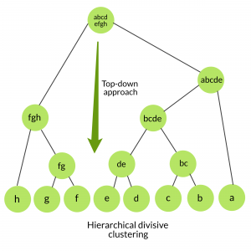
Algorithm of hierarchical cluster
1. Initialize: Assign each data point to its own cluster.
2. while (not converged):
2.1. Find the two closest clusters based on a distance metric.
2.2. Merge the two closest clusters into a larger cluster.
2.3. Recalculate the distance between the new cluster and the remaining clusters.
2.4. If the desired number of clusters is reached, stop.
3. Output: The final clusters and their respective centroids.

Slide 9
3.DSBSCAN-DBSCAN (Density-Based Spatial Clustering of Applications with Noise)
It is a popular clustering algorithm in machine learning that is used to group together data points that are close to each other in terms of a density criterion.
The algorithm works by grouping together data points that are close to each other and have a high density of neighboring points. It also identifies data points that are not part of any cluster as noise.
DBSCAN is a versatile algorithm that can handle complex data structures and is not sensitive to the initial placement of the centroids.

Slide 10
Algorithm for DSBSCAN:
1.Initialize: Choose the parameters eps (the radius of the neighborhood around a data point) and minPts (the minimum number of points required to form a dense region). 2. For each data point x in the data set: 2.1. Mark x as visited. 2.2. Find all the data points within a distance of eps from x. 2.3. If the number of data points found is less than minPts, mark x as noise. 2.4. Otherwise, create a new cluster C, add x to C, and mark all the reachable data points from x as visited and add them to C. 2.5. For each data point y in C: 2.5.1. If y is not visited, mark y as visited. 2.5.2. Find all the data points within a distance of eps from y. 2.5.3. If the number of data points found is greater than or equal to minPts, add them to C. 2.5.4. If y has not already been assigned to a cluster, add it to C. 3. Output: The clusters and the noise points.

Slide 11
Applications of clustering:
Customer Segmentation: Clustering can be used to group customers based on their purchasing behavior, preferences, demographics, or other characteristics. This information can be used to personalize marketing strategies, improve customer satisfaction, and increase revenue.
Image Segmentation: Clustering can be used to segment images into different regions based on their pixel values, allowing for image recognition and analysis. This is commonly used in medical imaging, remote sensing, and computer vision applications.
Anomaly Detection: Clustering can be used to identify anomalies or outliers in datasets that may be indicative of fraud, errors, or other unusual events.
Recommendation Systems: Clustering can be used to group users with similar preferences or behaviors, allowing for personalized recommendations to be made to users.
Text Clustering: Clustering can be used to group similar documents, allowing for better organization and retrieval of information.
Market Segmentation: Clustering can be used to group consumers based on their purchasing habits and preferences, allowing for more targeted marketing efforts.
Social Network Analysis: Clustering can be used to identify communities or groups of users within a social network, allowing for better understanding of social structures and behaviors.

Slide 12
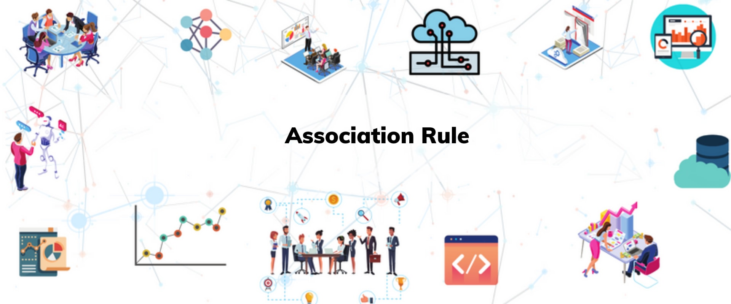
Association learning:
Association learning, also known as association rule learning, is a technique in machine learning that is used to identify relationships between variables in large datasets. It is primarily used in market basket analysis, where the goal is to identify which items tend to be purchased together.

Slide 13
Association rule learning can be divided into three types of algoritms:
Apriori
Eclat
F-P Growth Algorithm

Slide 14
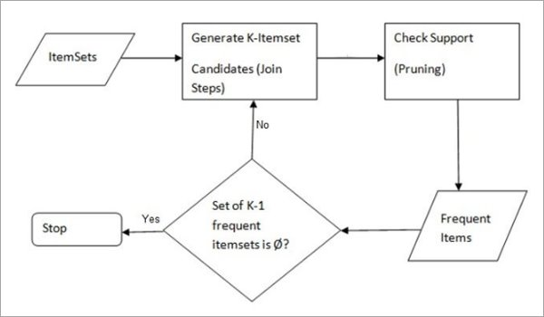
1.Apriori:
Apriori is a classic algorithm in machine learning used for association rule learning, which is a method for discovering interesting relationships between variables in large datasets.
The algorithm takes as input a dataset containing a large number of transactions and a minimum support threshold.
The minimum support threshold is a user-defined parameter that determines the minimum number of transactions in which an itemset must appear to be considered "frequent."

Slide 15
Algorithm for apriori
Apriori(D, min_sup): L_1 = generate_frequent_1_itemsets(D, min_sup) #generates frequent 1- itemsets from database L = [L_1] k = 2 while L_{k-1} is not empty: C_k = generate_candidate_itemsets(L_{k-1}) L_k = []
for each itemset in C_k: if support_count(itemset, D) >= min_sup: L_k.append(itemset) L.append(L_k) k = k + 1 return L

Slide 16
2.ECLAT-Equivalence Class Clustering and Bottom-Up Lattice Traversal:
It is an algorithm used for mining frequent itemsets, similar to the Apriori algorithm.
The Eclat algorithm is based on a depth-first search approach that traverses the lattice structure of itemsets, where each node represents a subset of items, and the edges between nodes represent the inclusion relationship between the itemsets.
The algorithm works by first constructing a vertical data structure called an "equivalence class," which is a list of all transactions containing a given item. Then, the algorithm generates frequent itemsets by recursively intersecting equivalence classes.

Slide 17
Algorithm for ECLAT:
Eclat(D, min_sup): L_1 = generate_frequent_1_itemsets(D, min_sup) L = L_1 while L is not empty: L_k = [] for each itemset in L: for each remaining_itemset in L: if the two itemsets share the same prefix: new_itemset = combine(itemset, remaining_itemset)
if support_count(new_itemset, D) >= min_sup: L_k.append(new_itemset)
L = L_k
return L

Slide 18
Unlike the Apriori algorithm, Eclat does not generate candidate itemsets. Instead, it uses a "depth-first" search approach to traverse the lattice structure of frequent itemsets, which can be more efficient in some cases. Eclat is also more memory-efficient than Apriori since it only stores the itemsets' tidsets, which are the sets of transaction IDs containing each itemset.
The Eclat algorithm is widely used for mining frequent itemsets in large datasets, particularly in market basket analysis, and has been shown to be effective and efficient in several studies.

Slide 19
3. F-P Growth Algorithm:
The FP Growth algorithm is a frequent pattern mining algorithm used for discovering frequent itemsets in a dataset. It is an improvement over the Apriori algorithm and is especially useful when dealing with large datasets.
FPGrowth only needs to store the FP-Tree and a few additional data structures, making it more memory-efficient than the Apriori algorithm.
FPGrowth is widely used in market basket analysis, recommendation systems, and other applications that involve discovering frequent itemsets.
FPGrowth can handle high-dimensional data, making it useful for applications that involve many attributes or features.

Slide 20
Algorithm for F-P growth :
FP-Growth(D, min_sup): L_1 = generate_frequent_1_itemsets(D, min_sup) FPTree = construct_frequent_pattern_tree(D, L_1) frequent_patterns = [] def find_frequent_patterns(prefix, conditional_pattern_base): frequent_itemsets = generate_frequent_1_itemsets(conditional_pattern_base, min_sup) for itemset in frequent_itemsets: support = support_count(itemset, conditional_pattern_base)
frequent_pattern = prefix + itemset frequent_patterns.append((frequent_pattern, support)) conditional_pattern_tree = construct_frequent_pattern_tree(conditional_pattern_base, itemset)
if not conditional_pattern_tree.is_empty():
find_frequent_patterns(frequent_pattern, conditional_pattern_tree) for itemset in L_1: support = support_count(itemset, D) frequent_patterns.append(([itemset], support) conditional_pattern_base = get_conditional_pattern_base(FPTree, itemset)
if not conditional_pattern_base.is_empty(): find_frequent_patterns([itemset], conditional_pattern_base)
return frequent_patterns

Slide 21
Applications of association learning:
Market based analysis: analyses shopping behavior of customers.
Customer segmentation: useful to segment customers based on purchasing behaviour
Medical diagnosis: identifies patterns in patient data
Fraud detection : detects fraudulent behavior in financial transactions.
Recommender systems: generates recommendations for items based on purchase history.

